Slide 1
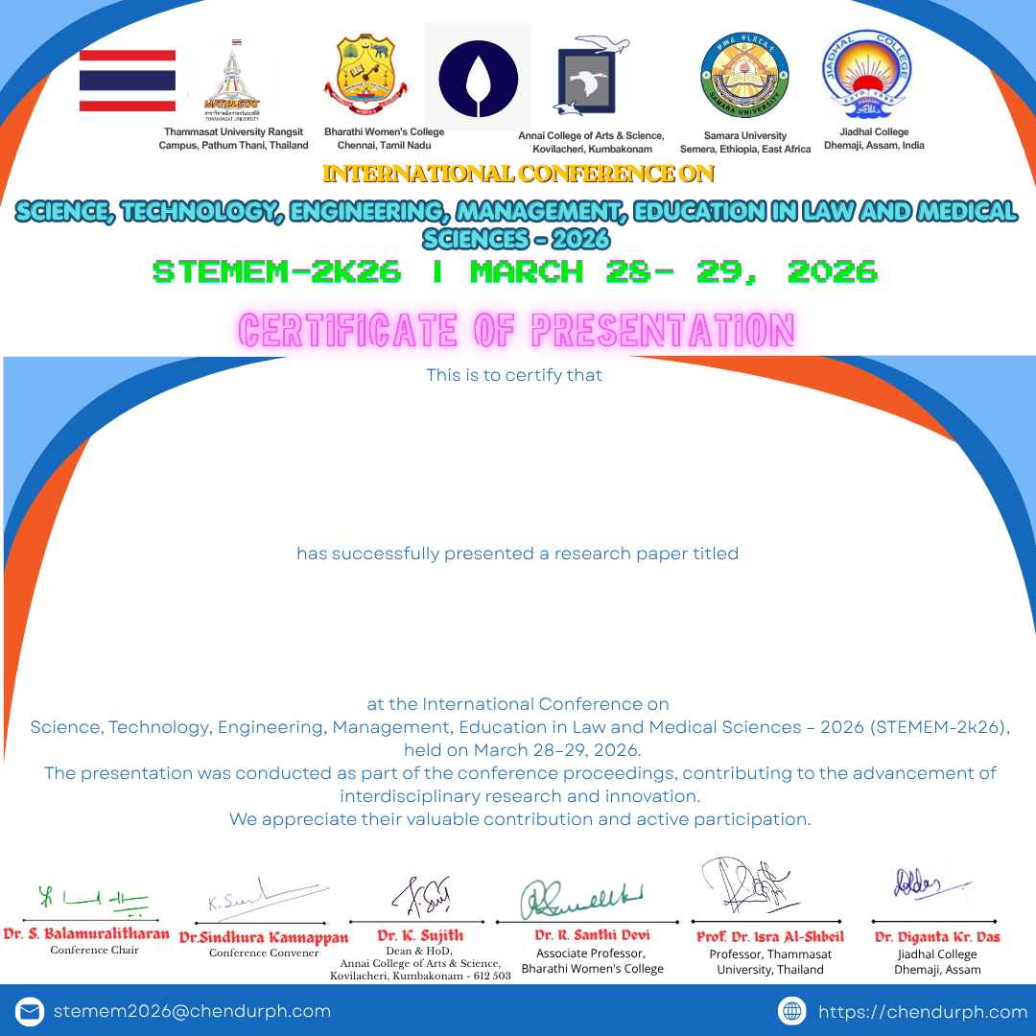
Godhawari . P
Assistant Professor - VISTAS
A Study On Cybersecurity Laws And Business Liability In India

